Slide 1
Depth Enhancement Using Adaptive Auto Regressive Model
Rishab Shah, Fan Cao
5/3/2017

Slide 2
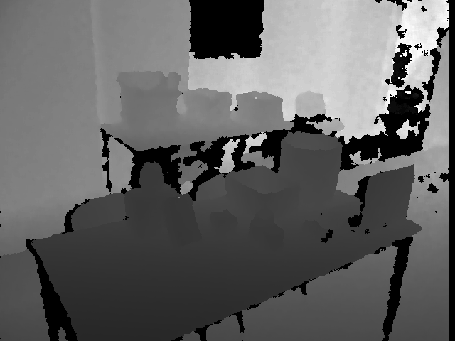
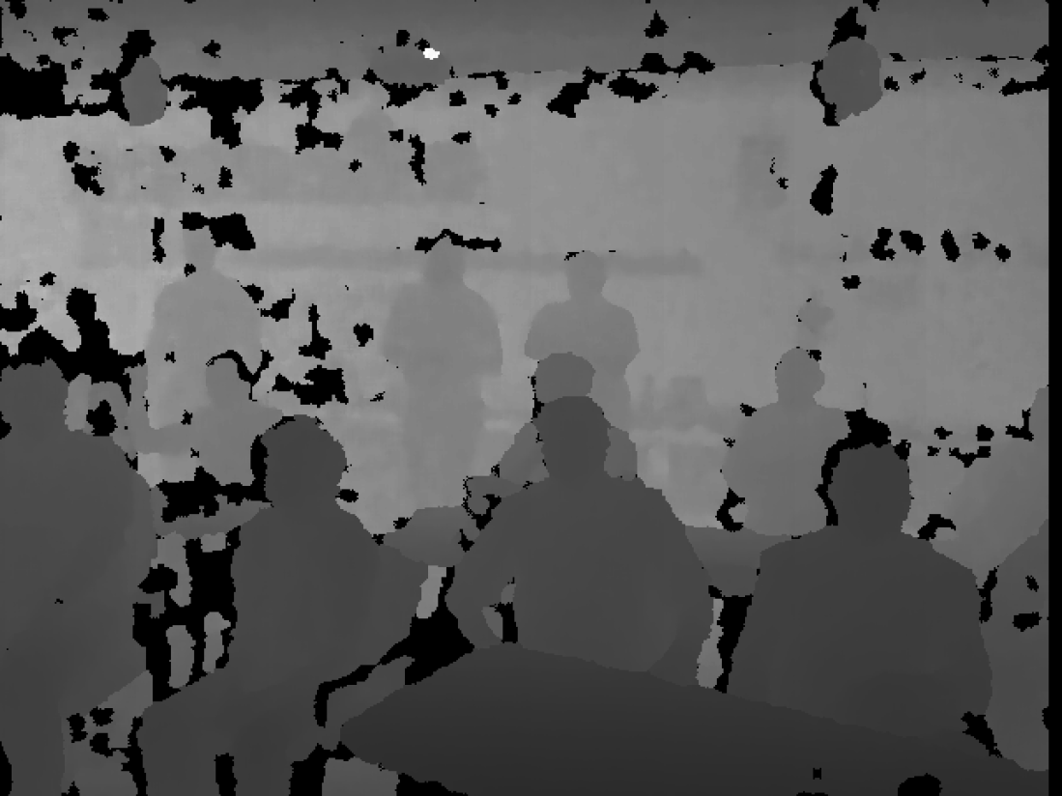
Kinect and its fallacies
Depth Degradation
Noise
Low Resolution
Structural depth data missing
Does not work with transparent objects or highly lit areas
Images from the UCL RGB-D dataset

Slide 3

Assumptions
Depth map and its corresponding color image is calibrated.
Not looking at transparent or highly-lit areas.
Recovery of only a single depth map at a time.

Slide 4
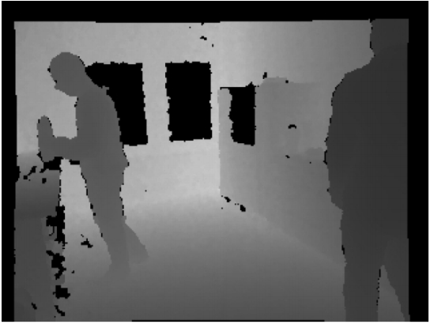
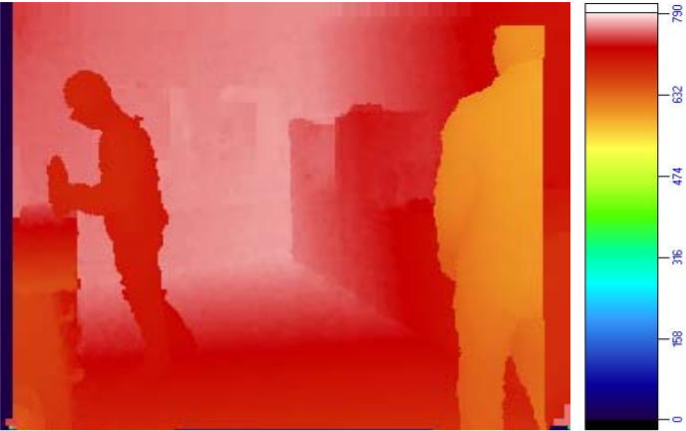
Prior Solutions
Inpainting
M. Stommel and M. Beetz and W. Xu, “Inpainting of Missing Values in the Kinect Sensor's
Depth Maps Based on Background Estimates”, IEEE Sensors Journal, vol. 14,
Pages 1107-1116, 2014

Slide 5
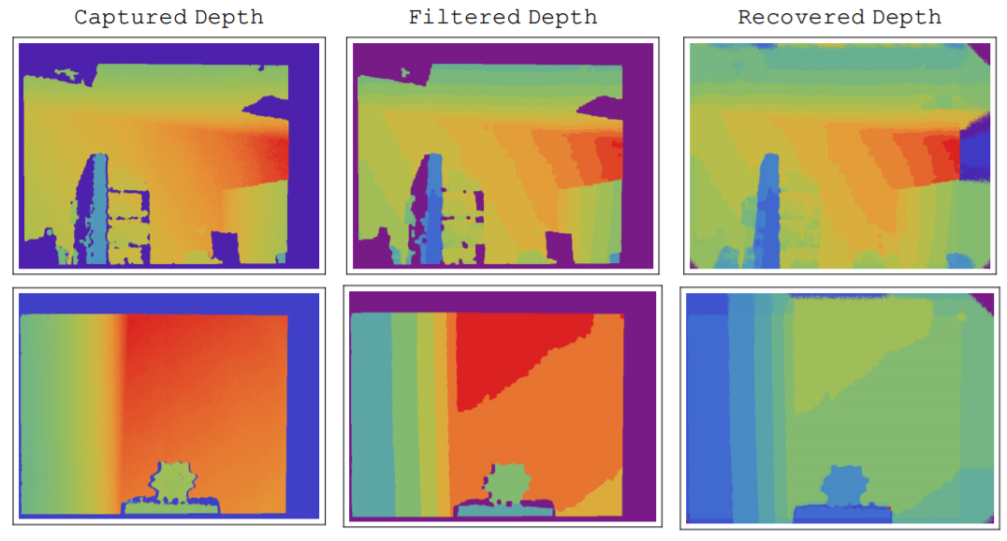
Prior Solutions
RGBD segmentation and data diffusion
A. Dakkak and A. Husain, “Recovering missing depth information from
Microsoft’s Kinect,” in Proc. Embedded Vis. Alliance, Boston, MA,
USA, 2012.

Slide 6
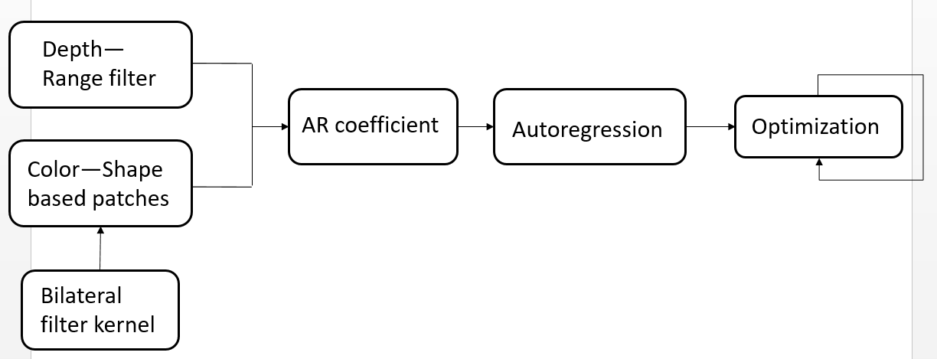
Proposed Solution
Adaptive Autoregressive model

Slide 7
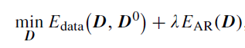
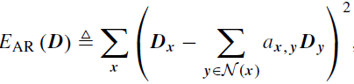
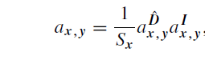
Proposed Solution
Adaptive Autoregressive model

Slide 8
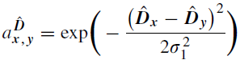


Proposed Solution
Depth Term
Rough map by interpolation
Range filter
Nearest Neighbor interpolation

Slide 9
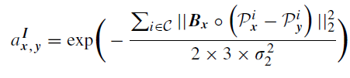
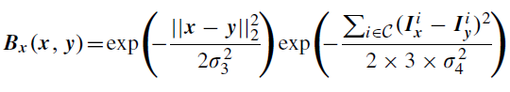
Proposed Solution
Color Term
Shape-based neighborhood
YIQ space
“Patches” of size 3x3
Bilateral filter of size same as the “patch”

Slide 10
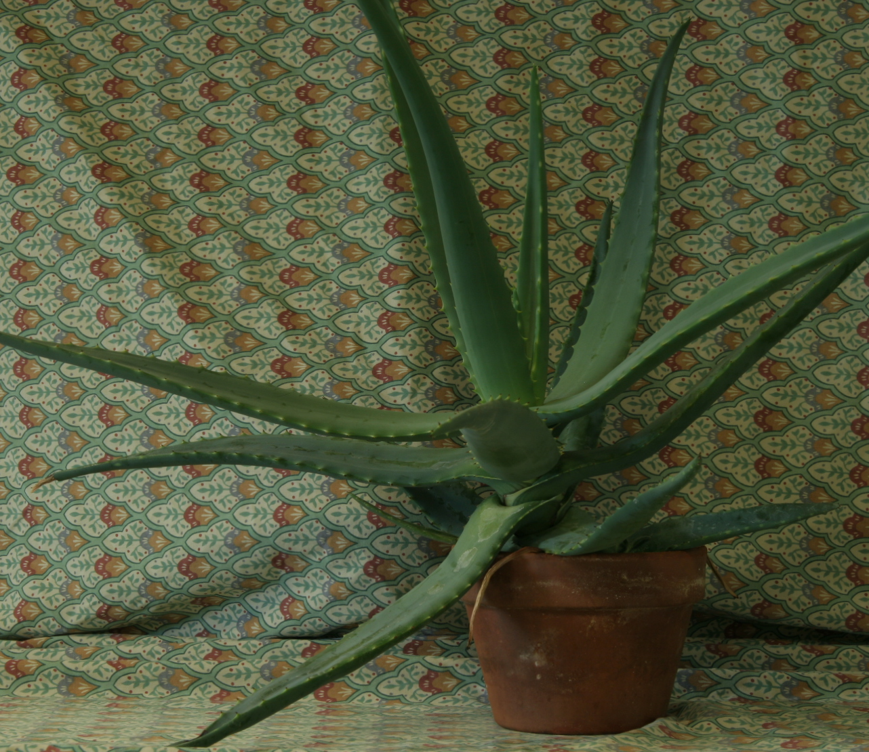
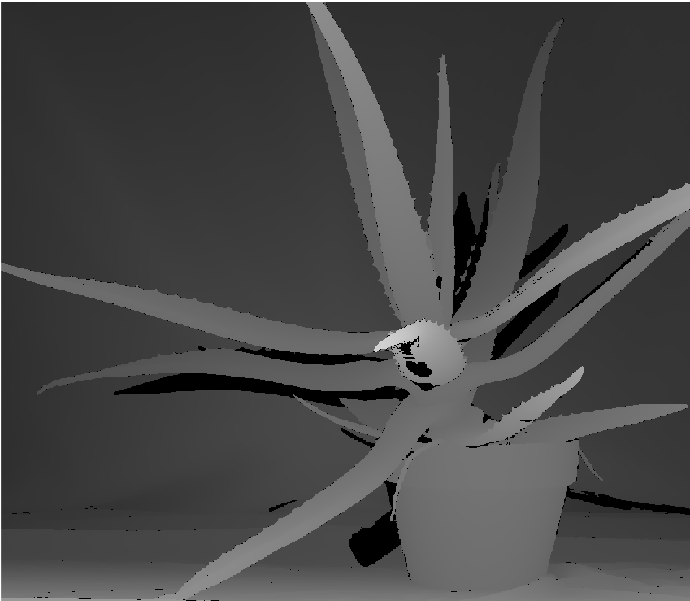
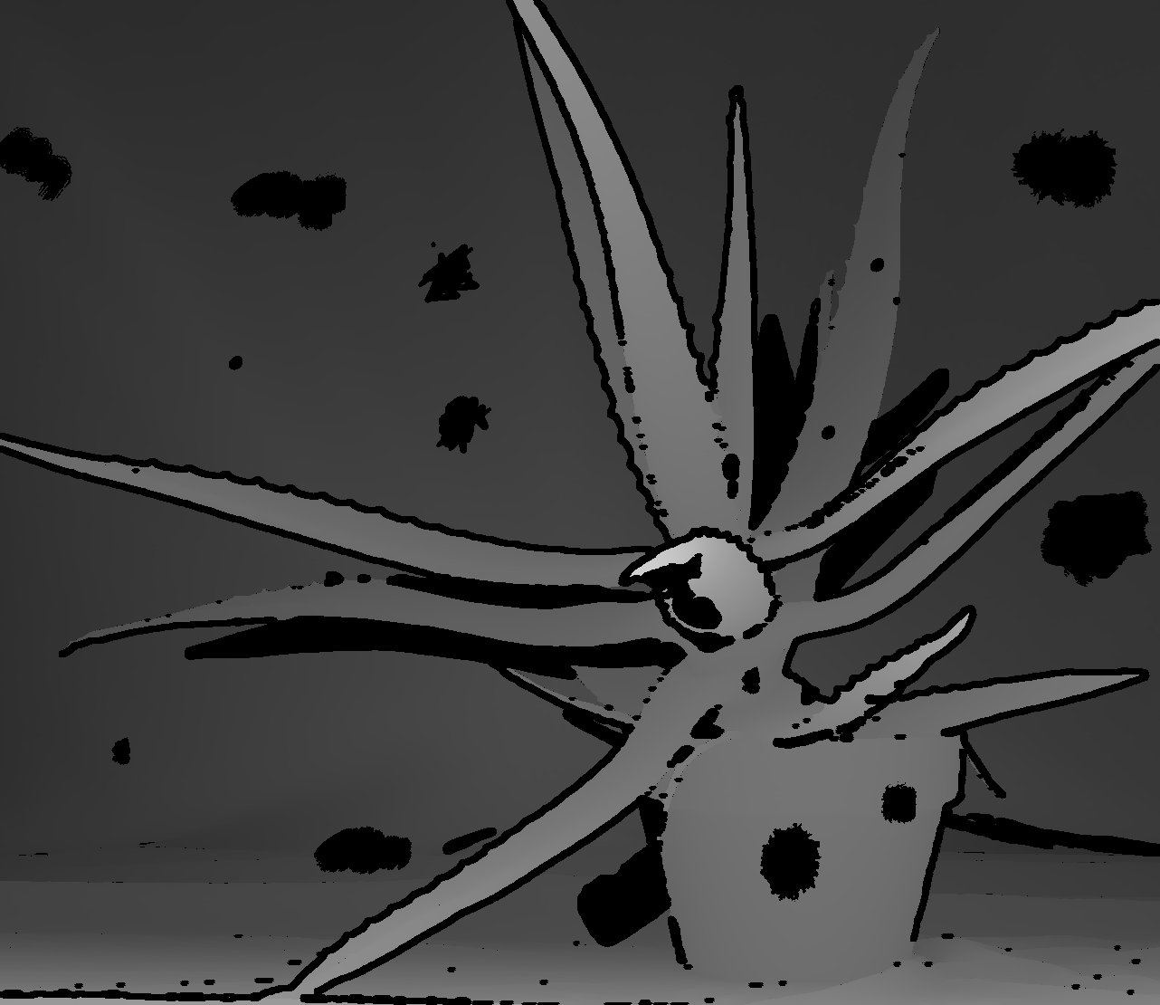

Results
Color and Ground truth image
Synthetically degraded and filtered image

Slide 11

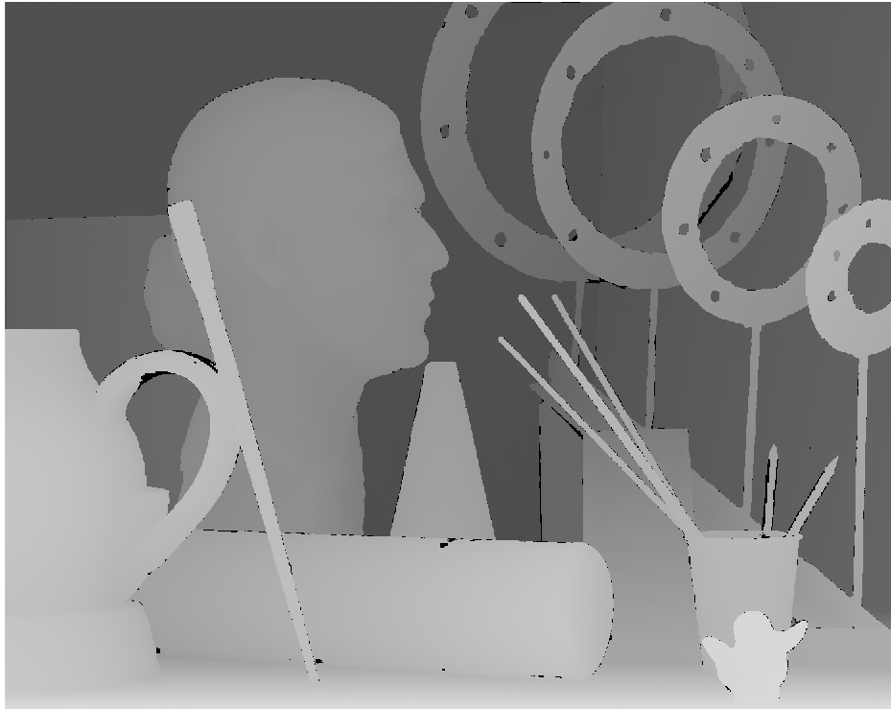
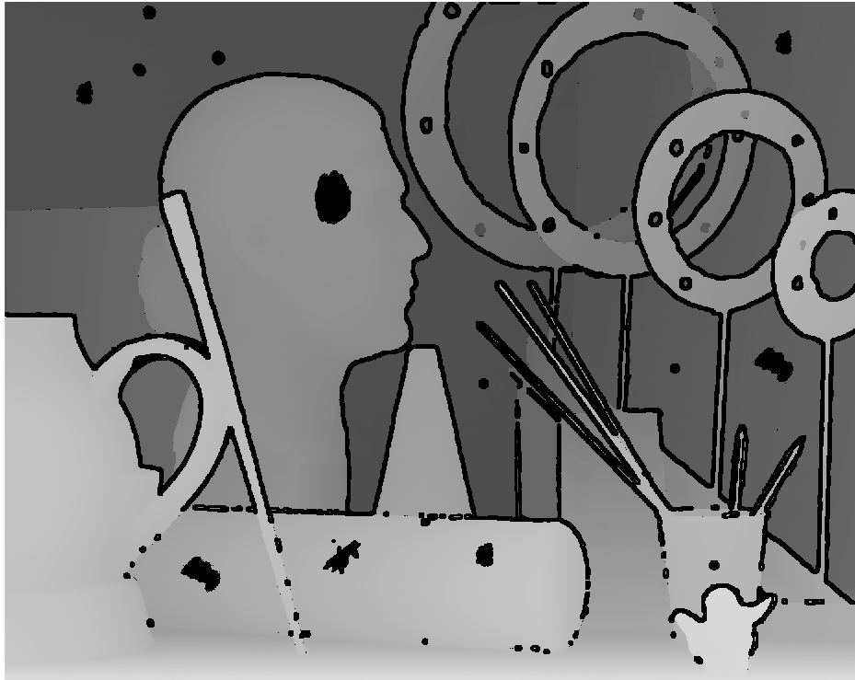

Results
Color and Ground truth image
Synthetically degraded and filtered image

Slide 12
Results
 | Resolution | MSE | PSNR | SSIM
Aloe Plant | 1282x1110 | 0.016 | 17.9533 | 0.7948
Head | 1390x1110 | 0.0274 | 15.6266 | 0.8092
Run time=~2 hours
Images from Middlebury dataset, 2005

Slide 13
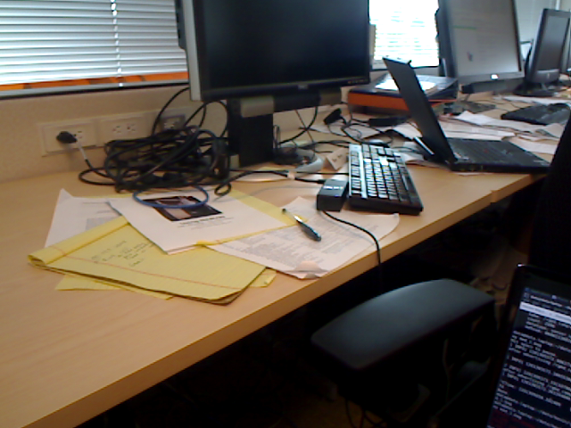

Results
Run time: ~1 hour
Resolution: 640x480

Slide 14
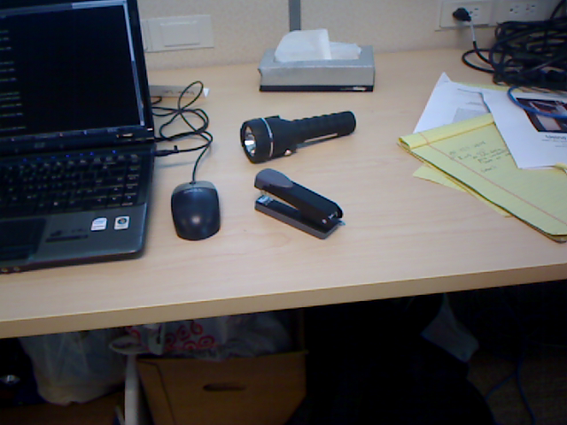


Results
Run time: ~1 hour
Resolution: 640x480

Slide 15
Conclusion & Future Work
Present a novel framework to recover depth maps.
AR predictors that are adaptive to the characteristics of the depth maps.
Proposed system has a linear optimization problem.
Code more efficiently.
Develop a method for temporal denoising.

Slide 16
Thank You
FUN FACT: Kinect for Xbox 360 is the fastest selling consumer gaming add-on device with over 24 million devices sold.

Slide 17
References
J. Yang and X. Ye and K. Li and C. Hou and Y. Wang, “Color-Guided Depth Recovery From RGB-D Data Using an Adaptive Autoregressive Model”, IEEE Transactions on Image Processing, 2014, vol.23, pages 3442-3458.
D. Scharstein and C. Pal. ”Learning conditional random fields for stereo.” In IEEE Computer Society Conference on Computer Vision and Pattern Recognition (CVPR 2007), Minneapolis, MN, June 2007.
K. Lai, L. Bo, X. Ren, and Dieter Fox, “A Large-Scale Hierarchical Multi-View RGB-D Object Dataset”, IEEE International Conference on Robotics and Automation (ICRA), May 2011.

